Slide 1
LOGIC BASED PATTERN DISCOVERY USING COHERENT RULES
By
Sayali Sakhalkar(94)
Sonal Chaplot(124)
Apurva Kulkarni (131)
Under the guidance of
Mrs. Arti Deshpande

Slide 2
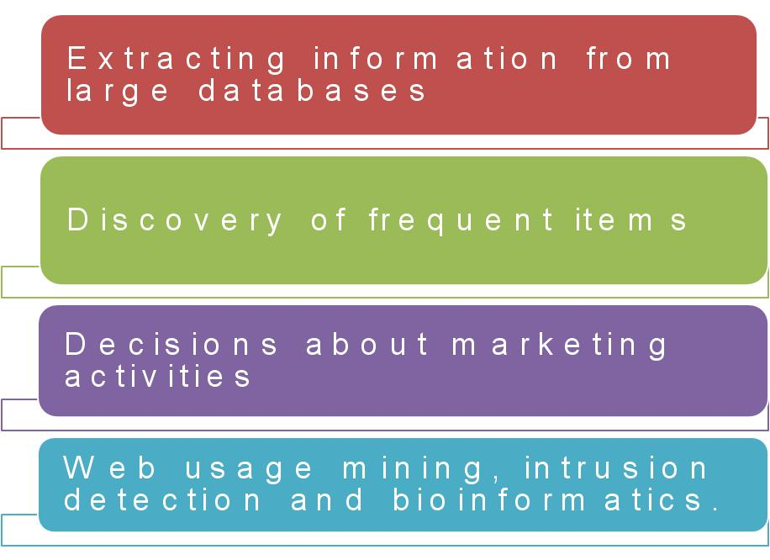
PATTERN DISCOVERY?

Slide 3
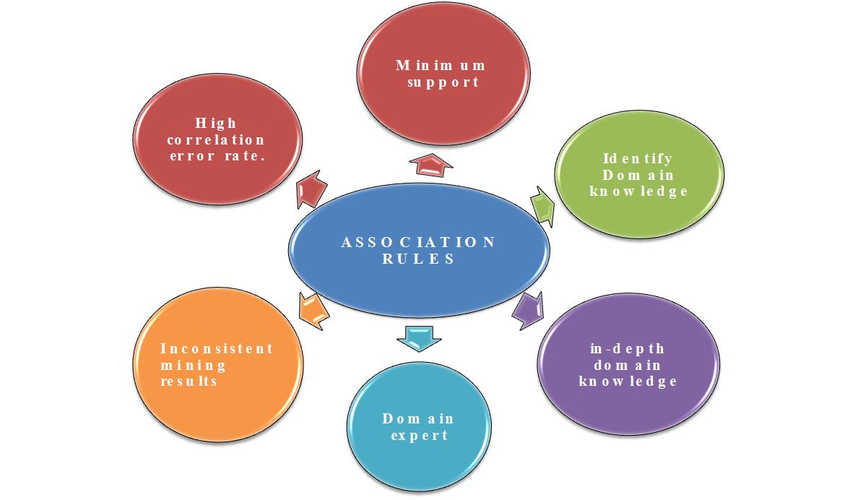
Existing Solution

Slide 4
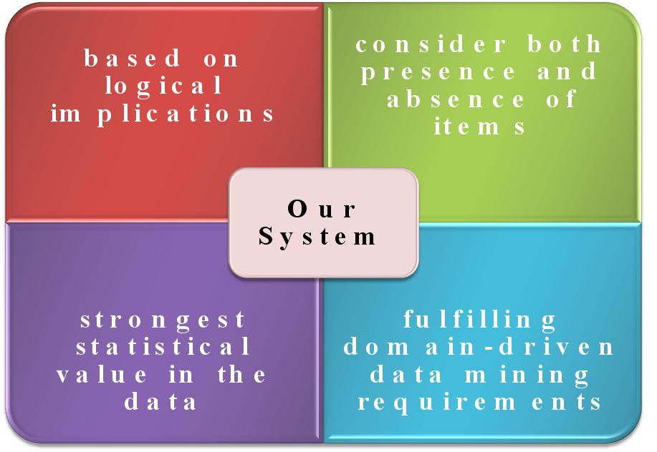
PROPOSED SYSTEM

Slide 5
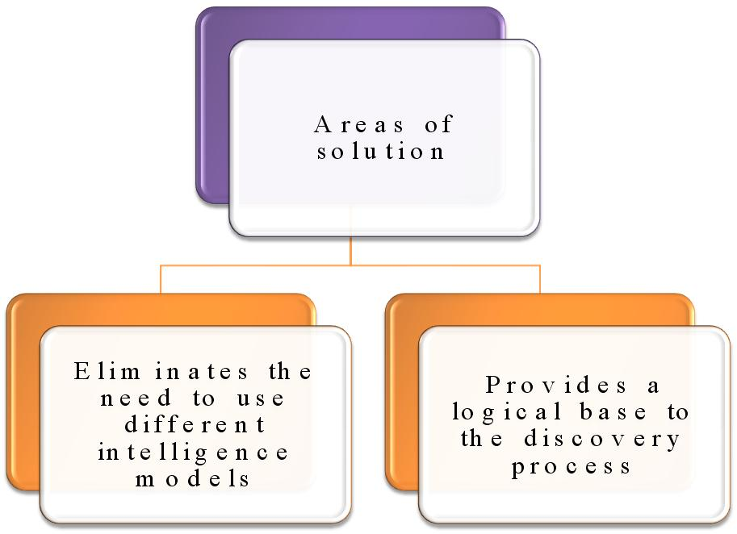

Slide 6
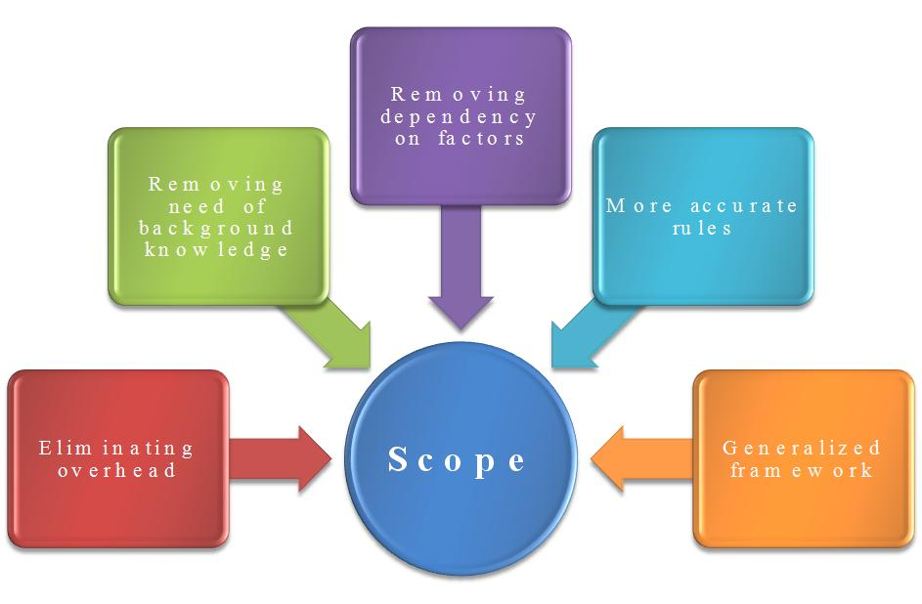
Scope

Slide 7
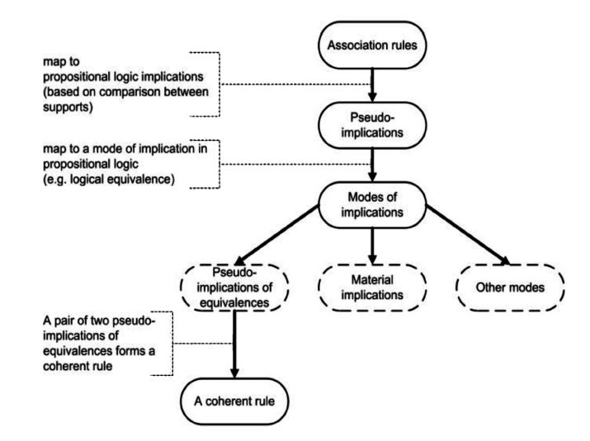
Generalized framework based on Association Rules

Slide 9
Implication
Formed using two propositions p & q which can be either true or false based on implication’s interpretation
E.g.
p : “apples are observed in a customer market basket”
q : “Bread is not observed in a customer market basket”

Slide 10
From the proposition made we have four implications:
p → q
p → ¬q
¬p → q
¬p → ¬q

Slide 11
Mapping Using Multiple Transaction Records
Support S(X) = |Dx|
S(X) → number of times X observed in entire data set
S(¬X) → number of times X not observed in entire data set
Accordingly items mapped to propositions

Slide 12
An association rule can be mapped to implication if and only if item set (X,Y) is interesting
E.g. Association X => Y can be mapped to p → q if :
S(X,Y) > S(X,¬Y)
S(X,Y) > S(¬X,¬Y)
S(X,Y) > S(¬X,Y)
This is known as pseudo implication

Slide 13
Record to be considered as COHERENT RULE
S(X,Y) > S(X,¬Y)
S(X,Y) > S(¬X,Y)
S(¬X,¬Y) > S(¬X,Y)
4. S(¬X,¬Y) > S(X,¬Y)

Slide 14
Starting with working of System…

Slide 15
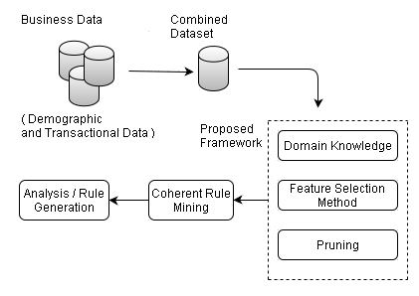
Architecture of Proposed System

Slide 16
Detail Explanation of each Step

Slide 17
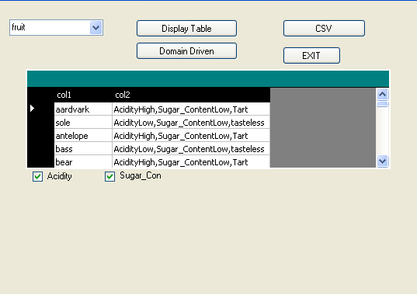
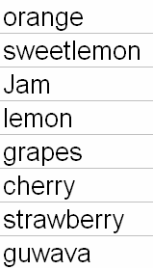
Step 1: Selection, Display and CSV format of database
CSV form of database
Here we are considering fruit database…
List of Databases
To display selected
database
List of Attributes in
Database

Slide 18
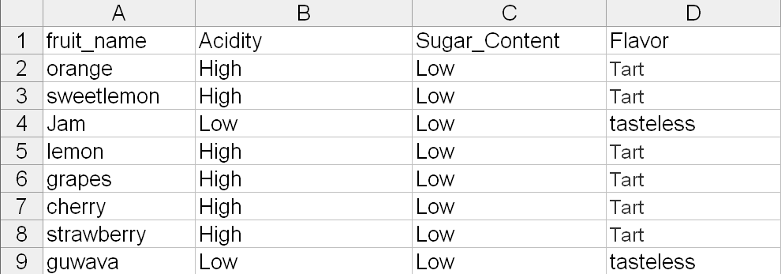
Database as Input

Slide 19
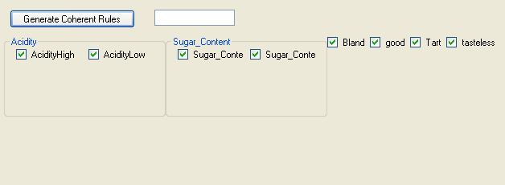
Step 2:Coherent Rule Generation

Slide 20
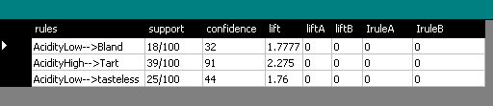
Step 3:Results

Slide 21
Total Rules Generated
Sugar_ContentHigh --> Bland;
sugar_ContentLow --> Tart;
Sugar_ContentLow --> tasteless;
AcidityLow --> tasteless;
AcidityLow,Sugar_ContentLow --> tasteless;
AcidityLow --> Bland;
AcidityLow,Sugar_ContentHigh --> Bland;
AcidityHigh,Sugar_ContentLow --> Tart;
AcidityHigh --> Tart;
Given Mapping
Acidity | Sugar content | Flavor
High | High | good
High | Low | bland
Low | High | tart
Low | Low | tasteless

Slide 22
OMG! There are so many rules! I want Rules Related to Tart only?

Slide 23
Here Is the Solution… DOMAIN DRIVEN APPROACH…!

Slide 24
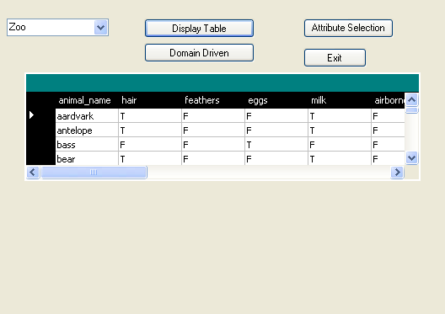
Step 1: Selection of table

Slide 25
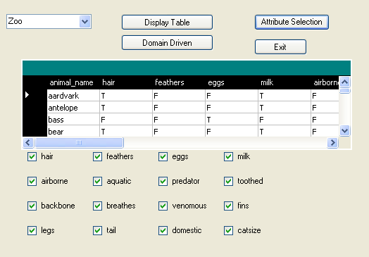
Step 2:Display of table

Slide 26
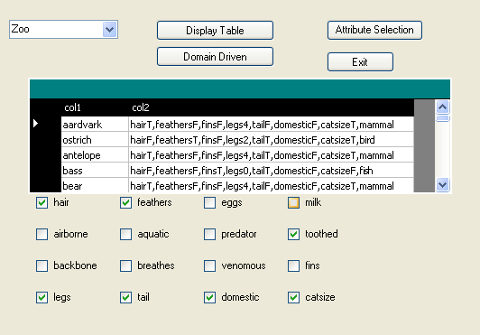
Step 3:Selecting Attributes of Interest

Slide 27
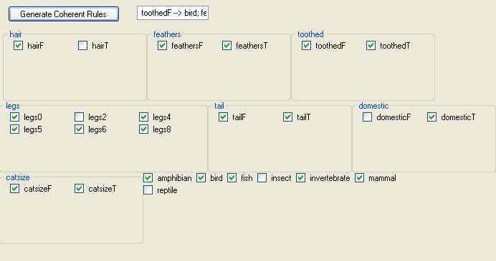
Step 4:Selecting Values of Attributes and Class of Interest
Selection of class
“Domain Driven”

Slide 28
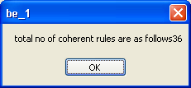
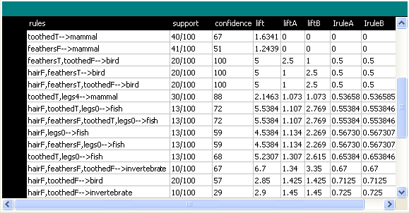
Step 5:Generated Rules

Slide 29
Little more in Detail…
Class [ ]: Unique class names
N: total number of classes in class[ ]
Set Items [ ]: Power set of unique selected items
M: total number of items in Items [ ]
db: dataset with k records
Algorithm:
domain_driven_coherent (Items [], class [])
BeginFor each record in Class [] // class labels
{
For each record in Items [] // power set
{
For each record in db // records
{
If (db[t].contains (class[j]))
{
If (db[t].contains (Item[i]))
ClassPresent_ItemPresent ++;
Else
ClassPresent_ItemAbsent ++;
}
Else
}
If (db[t].contains (Item[i]))
ClassAbsent_ItemPresent ++;
Else ClassAbsent_ItemAbsent ++;
} } }
End;
Output: Support Count Matrix

Slide 30
IMPLEMENTATION

Slide 31
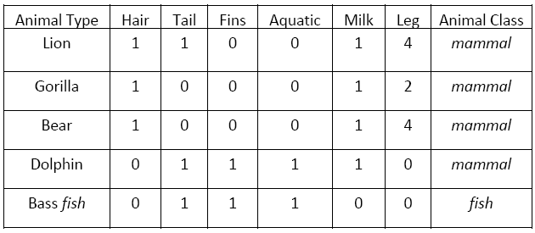
Testing
Proposed technique is tested on 3 classification datasets :
Zoo Dataset :

Slide 32
Coherent Rule Example 1
{Hair_False, Feathers_False, Legs_0 → Fish}
{Hair_False, Feathers_False, Toothed_False → Invertebrate}
{Toothed_True, Legs_4 → Mammal}

Slide 33
2. Fruit Dataset :
Fruit Name | Acidity | Sugar Content | Flavor
A | High | Low | Tart
B | High | Low | Tart
C | Low | Low | Tasteless
D | Low | High | Bland
E | Low | Low | Tasteless
F | High | High | Good
G | Low | High | Bland
H | High | High | Good

Slide 34
Coherent Rule Example 2
Acidity_Low, Sugar_Content_High --> Bland
Acidity_High, Sugar_Content_Low --> Tart
Acidity_High, Sugar_Content_High --> Good

Slide 35
3. Retail Dataset :
ID | MARITAL -STATUS | GENDER | BLUETOOTH- HEADPHONE | CAR- VIDEO | HOME- THEATER- SYSTEM | MP4- MP3 | RECORDING- PHONE | TELEVISION | VCD- DVD | CLASS-CUSTOMER
1 | M | F | F | F | F | F | T | F | F | HIGH
2 | M | F | F | F | F | F | T | F | F | HIGH
3 | M | F | F | T | F | F | F | F | F | MODERATE
4 | M | F | F | F | T | F | F | F | F | LOW
5 | S | F | F | T | F | F | F | F | F | MODERATE

Slide 36
Coherent Rule Example 3
Marital_status_Married,Bluetooth_Headphone_False -->HIGH
Gender_Female,Bluetooth_Headphone_False, Car_Video_False-->MODERATE
Marital_status_Married,Gender_Male, Bluetooth_Headphone_True-->LOW

Slide 37
Further Optimization……Why????
10,000 Rules
1,000 Rules
1,00 Rules
Complexity
Reduced
Decision Making
Process Reduced

Slide 38
Ways of Optimization
Domain-Driven
Pruning

Slide 39
Domain – Driven Method
Concentrate on the data belonging to a particular domain of interest, thus reducing unnecessary processing of non-required data
Reduces Time and Space Complexity
Computation Cost Reduced drastically
User happiness because of the provision given to state its choice

Slide 40
Pruning
Selects only those rules which are having both the properties of static dataset d as well as transactional dataset t and lift >=1.
E.g.
Marital_status_Married-->HIGH
Gender_Male-->LOW
Marital_status_Married, Gender_Male->LOW

Slide 41
Gender_Female,Bluetooth_Headphone_False,Car_Video_False--->HIGH
Gender_Male, Marital_Status_Single, Bluetooth_Headphone_True,
Car_Video_False--->LOW

Slide 42
Terms involved in process of Pruning
Pruning Process
Support
Confidence
IruleA
Lift
Irule
IruleB
LiftA
LiftB

Slide 43
Illustration
Rule | Support | Confid-ence | Lift | LiftA | LiftB | IruleA | IruleB
Gender_Female-->HIGH | 58/139 | 73 | 1.24 | - | - | - | -
Gender_Female, Car_Video_False -->HIGH | 58/139 | 79 | 1.34 | 1.339 | 1.34 | 1.339 | 1.339
Marital_status_Married, Car_Video_False-->HIGH | 47/139 | 57 | 0.97 | 0.966 | 0.97 | 0.9661 | 0.9661
Gender_Female,Bluetooth_Headphone_False, Car_Video_False-->HIGH | 37/139 | 95 | 1.61 | 1.61 | 1.61 | 1.6102 | 1.6102

Slide 44
REFERENCES
1. Alex Tze Hiang Sim et. Al., “Logic based pattern discovery,” IEEE TRANSACTIONS ON KNOWLEDGE AND DATA ENGINEERING, VOL. 22, NO. 6, JUNE 2010 ---> Main Paper
2. C. Longbing, “Introduction to Domain Driven Data Mining,” Data Mining for Business Applications, L. Cao, P.S. Yu, C. Zhang, and H. Zhang, eds., pp. 3-10, Springer, 2008. ---> Domain-Driven concepts
3. L. Cao, P. Yu, C. Zhang, and H. Zhang. “Data Mining for Business Applications,” Springer, 2009 ---> How business can be flourished ..?
4. X. Wu, C. Zhang, and S. Zhang, “Efficient Mining of Both Positive and Negative Association Rules,” ACM Trans. Information Systems, vol. 22, pp. 381-405, 2004. ---> Importance of +ve and -ve rules
5. Arti Deshpande and Anjali Mahajan “Domain Driven Multi-Feature Combined Mining for retail dataset,” International Journal of Engineering and AdvancedTechnology (IJEAT) Volume-2, Issue-3, February 28, 2013 Available: http://www.ijeat.org/article.php
---> Introduction to Combined Rule Mining

Slide 45
THANK YOU...

